Slide 1
Moving Applications to the Cloud
Kyle Brown
Distinguished Engineer
IBM Cloud Lab Services
brownkyl@us.ibm.com

Slide 2
Agenda
1. General overview of "Why would you migrate or Renovate"?
2. Specific issues around making Java applications cloud-ready
3. Deciding how any particular application should be migrated
4. Under what circumstances you should choose each service in a renovation?

Slide 3
Why Renovate?

Slide 4

Why renovate or migrate?
From an enterprise perspective, there are two reasons why we see customers wanting to “renovate” their applications and make them work on Bluemix
The first is a “front-end renovation” where the customer is building a new UI (either a mobile application or a new Web UI or both) on top of existing functionality. Bluemix gives the customer a lot of options for front-end development in that case
The second is a “full renovation” where the application needs to be ported as a whole (or in large part) to Bluemix as its new platform. That’s especially true when the customer wants to take advantage of the more modern programming or scaling features of Bluemix.
Both of these have pros and cons, and there are different aspects you have to consider when doing each – but also different potential benefits to go with the challenges

Slide 5
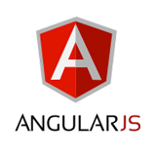


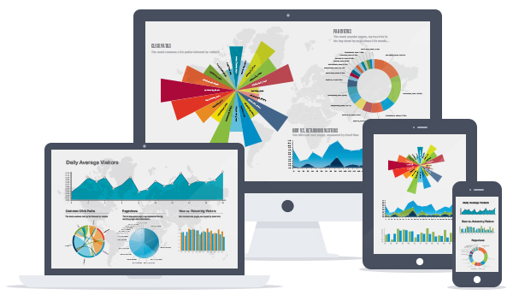
Front-End Renovation options
Some options to think about for front-end renovation are:
Building a Mobile application (Hybrid or Native) using the Mobile features for Bluemix
Building a more modern Web application using Angular and Node
Adding in support for externally-written clients by exposing a public API
The big issue here is how you are doing this – you shouldn’t just take your existing web page and put it on your mobile application – this takes Design Thinking to address properly

Slide 6
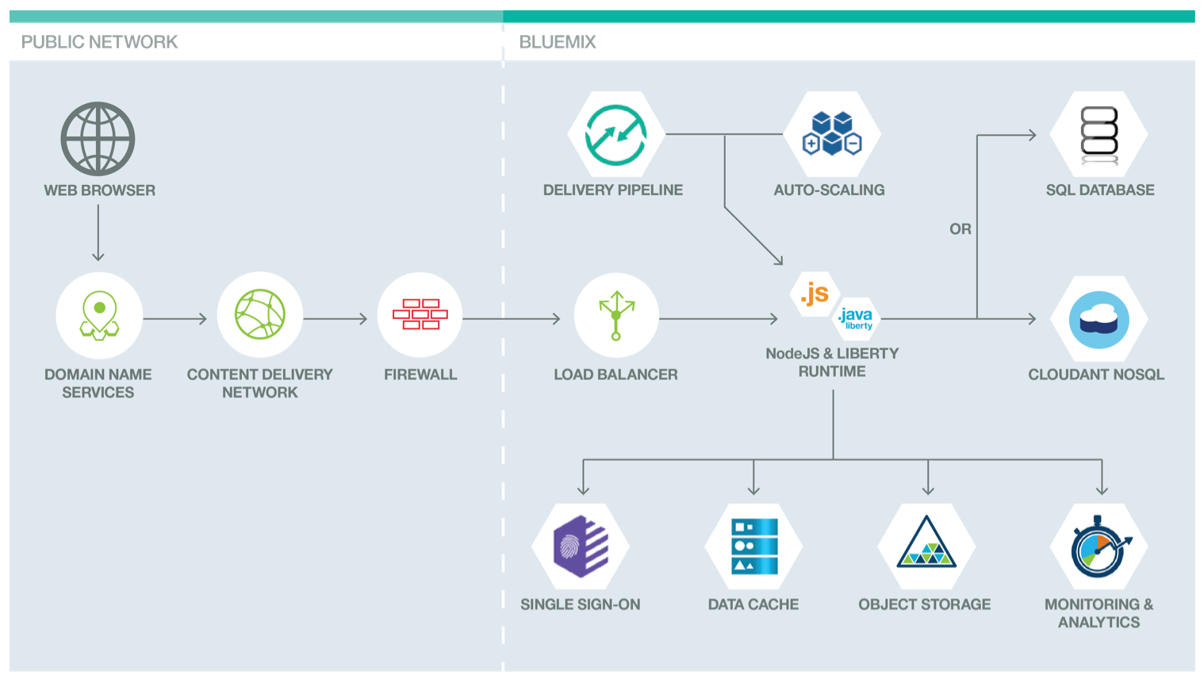
Full Renovation Options
When you’re doing a full modernization you have several new features you can take advantage of:
Migration to the newer JEE features is an obvious benefit
But you should also consider other options:
Modernizing your caching infrastructure
Modernizing your database infrastructure
Moving to APIs instead of directly connecting to back-end services
Modernizing your monitoring infrastructure
Taking advantage of a DevOps Pipeline
https://developer.ibm.com/bluemix/docs/actionable-architecture-building-web-application-hosting-cloud-foundry/

Slide 7
Considerations for Cloud Readiness

Slide 8

What does moving to Cloud mean for my applications?
Different applications may be better suited for either an IaaS or a PaaS approach. You need to approach the choice from the application’s perspective.
An existing application is Cloud-ready if it can be effectively deployed into either a public or private cloud (often but not always, an IaaS) without significant modifications.
Certain architectural decisions can make applications not cloud-ready
Cloud-centric applications are those specifically written to run on the cloud, usually within a PaaS.
These applications are built using different tools and runtimes than traditional applications.
For example, an application might not use a relational database but instead use a NoSQL database, like Cloudant or MongoDB.
A Cloud-Centric application has a different set of assumptions about what is provided by its infrastructure and how.
The decision on whether you
need an IaaS or PaaS is
application dependent

Slide 9

Common characteristics of an Enterprise Application
Enterprise applications were usually not built with Cloud compatibility in mind, but may have been built with future-proofing in mind
Trying to catch up to the latest versions of libraries, etc.
May be built on WebSphere Stack products
Portals with WebSphere Portal Server
Purpose-built (Departmental) ESB’s built with DataPower and IIB
Deep ties into internal IT
Especially in cases where you not only read from, but update systems of record
May read from and update multiple systems not specified as API’s
Deep ties into Corporate security systems (LDAP, ISAM, Siteminder) and standards
Often have high, and well-specified QoS attributes
Business customers have expectations on how often they are available and how they perform
You have to consider all of the business, architectural and design decisions of an application when moving to Cloud.

Slide 10
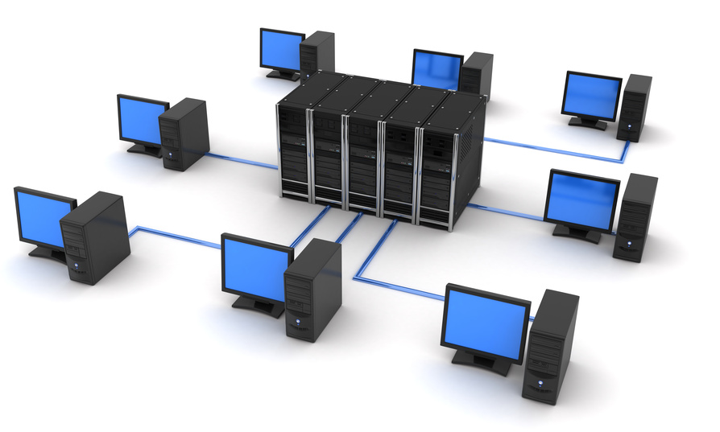

Differing Assumptions
Enterprise (Cloud Ready) Assumptions
The infrastructure provides my NFR’s.
The infrastructure is stable.
The components of my application are co-located.
My ops team controls the production servers.
If a disaster happens, it’s someone else’s responsibility to fix it.
Cloud Centric Assumptions
My application and my services provide my NFR’s.
The infrastructure is constantly changing (elastic).
My application components may be globally distributed.
As a Dev/Ops team member I control the production servers.
If a disaster happens, it’s my responsibility to make sure my app stays up.
Choosing one or the other
has an effect on your team
composition and roles

Slide 11

Security NFR’s
A key aspect of moving Enterprise applications to the Cloud is in compliance with Enterprise Security Requirements
Enterprises usually have Chief Information Security Officers (CISOs) who set policies regarding application and data security.
You want to work with the CISO instead of against them – non-compliant skunkworks projects are not the way to win hearts and minds!
Some of the concerns you may have to address to build Cloud applications compliant with Corporate security policies:
Legislated Privacy Requirements (incl. Data Location)
Required/Desired Levels of Isolation
Autnz/Authn/Identity Management
Audit Logging/Separation of Concerns
Encryption (at rest, in transit)

Slide 12
Making Applications Cloud Ready

Slide 13

9 criteria for cloud-ready applications
Application’s design is topology-agnostic
Ex: Clustering is supported, no specific cluster size needed
Application’s management is infrastructure-agnostic
Ex: Doesn’t depend on IP addresses, hostnames, or VLANs
Application doesn't use infrastructure-specific APIs
Application doesn't use OS-specific features
Application doesn't use the local file system
Application logs to persistent storage, not the file system
Application keeps session state only in the interaction layer
Application components connect via standard protocols
Application’s installation and configuration is scripted
Ex: Deployment is easily repeatable

Slide 14

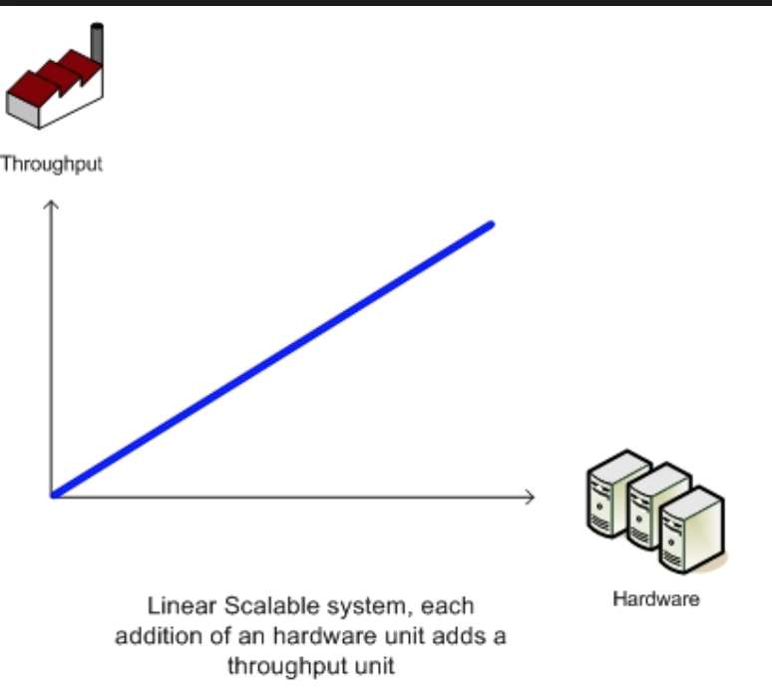


Other considerations for applications to be ported to Bluemix
Application Considerations:
The application needs to be on a recent, supported level of the runtime
Otherwise you’ll find your time gobbled up by porting to the newest level
The application needs to have linear, horizontal scaling
Vertical scaling is just not feasible for cloud
The application shouldn’t be a bandwidth hog
This is a shared environment, after all
The application should not need data at rest to be encrypted
Seriously limits your options for data sources

Slide 15

Infrastructure Modernization for Java applications
Plan on moving to Liberty as part of your infrastructure modernization plan
Goes hand in hand with a code refactoring
Moving to EJB 3.0 (local) or JEE Web Service Profile
Understanding dependencies on “bonus” or external parts of WAS ND (scripts, internal messaging, telecom classes)
Requires formulating a Liberty migration strategy
Use the Liberty migration tool
Classifying and evaluating applications for the migration
Classification criteria (# users, uptime, #data sources, tech stack)

Slide 16
Changing your applications
In most cloud migrations you’ll find that the application has to change at some level
The only way this works is if the customer has a good set of
Application tests (preferably automated)
Application performance baselines
Good processes for gaining access to test data
Application Refactoring Types – Behavior preserving Transformations
1. Breaking down applications by layer
Substituting layers with 9-rules compliant replacements
2. Breaking down applications along functional boundaries
Breaking larger applications into smaller ones
3. Breaking out services
Developing a shared services architecture
2
UI Layer
1
Service Boundary
Business Logic Layer
Data Services Layer
Data Sources
3

Slide 17

Paying Down Technical Debt
Build out a fully automated functional and performance test suite
Prerequisite for later steps
Develop a fully automated code and configuration deployment scheme
Rationalizes your SDLC lifecycle environment
Clean up unneeded internal dependencies
Rationalize/standardize on a common packaging approach and common set of 3rd party packages and jar files
Take the opportunity to refactor to either classical SOA or Microservices
Modernize your services infrastructure
Add caching, monitoring, etc…
Modernize your user interface
At least come up to date on framework versions
May want to move to Web 2.0/3.0 Hybrid model or consider Native mobile apps

Slide 18
Rebuilding applications for Cloud-Centricity

Slide 19
Design Principles for Bluemix
There are a number of design principles that Bluemix applications follow that may make them a bit different from traditionally constructed applications
Bluemix applications are “Born on the Cloud” and that implies (or enables) a number of new design principles
Many Bluemix applications are built using Microservices architectures
Most Bluemix application teams follow DevOps principles
Most Bluemix applications are built in accordance with the 12-factor.net rules
In general, Born on the Cloud applications
Have a shorter lifetime than traditional applications – new versions are rolled out very quickly
Are built using principles of polyglot programming and polyglot persistence

Slide 20
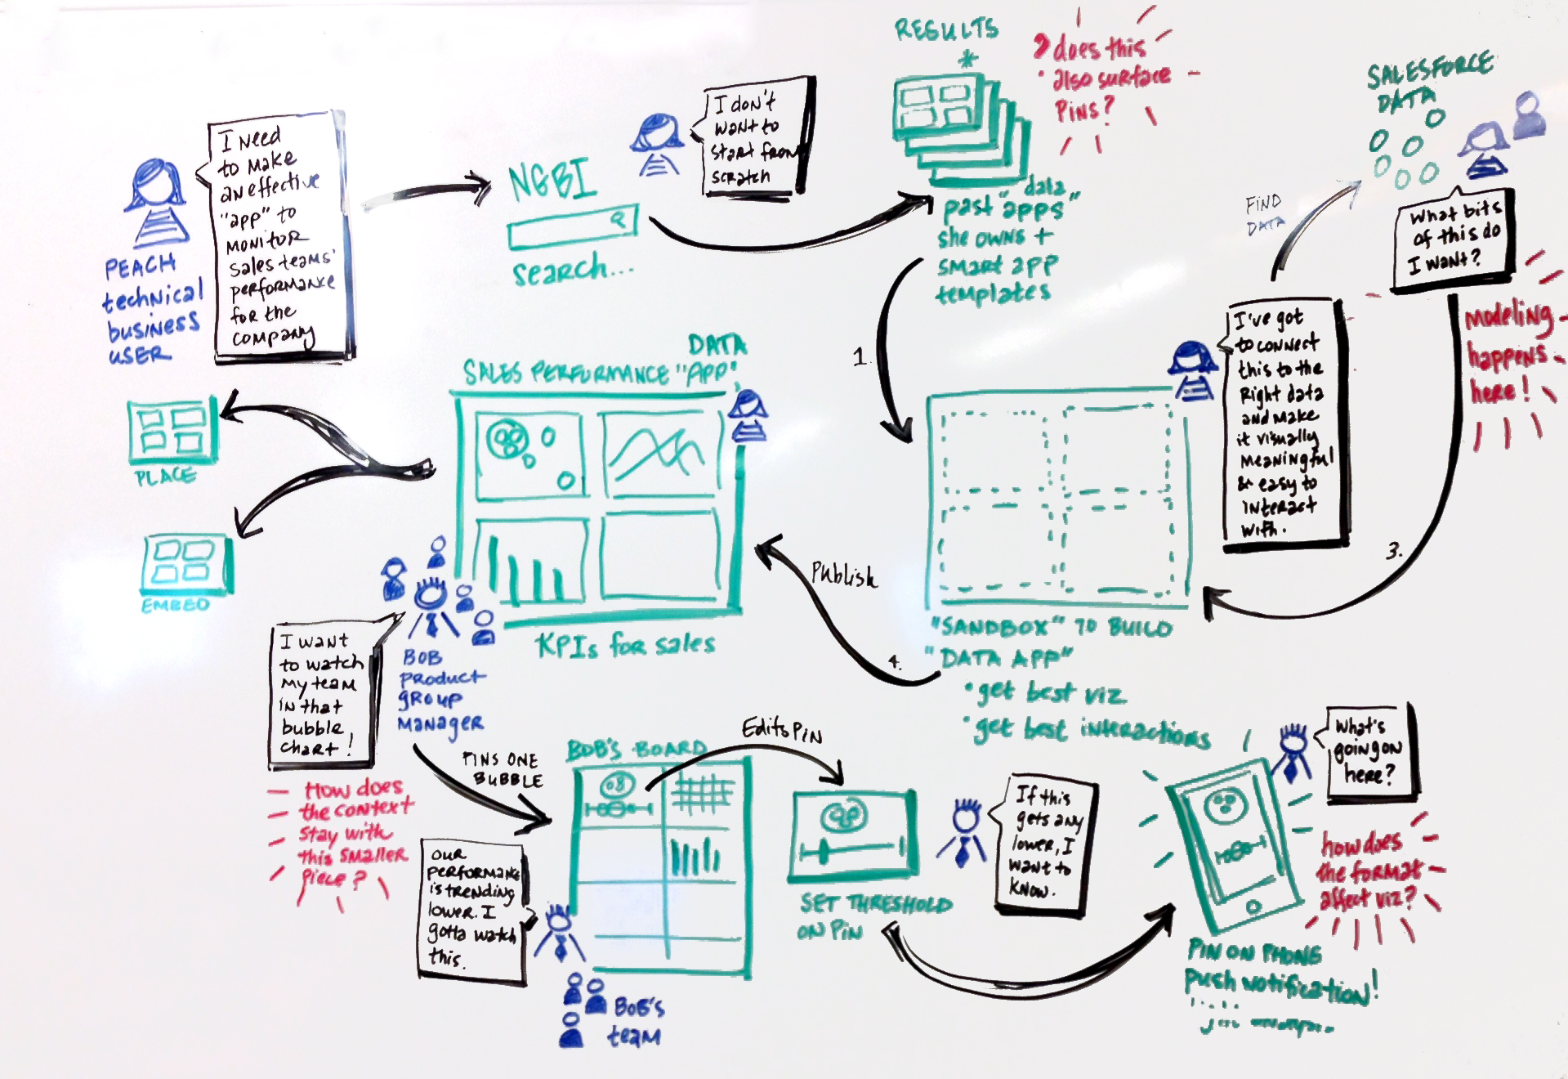
Cloud Centric Design Approach
Understand your Business Goals
Understand the target user experience
Pick your services/data sources
Determine your archetype
Pick your runtimes and libraries

Slide 21
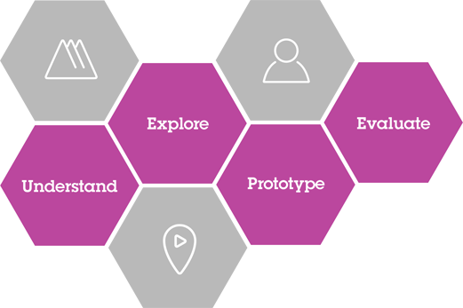
Understand the target user experience
Encourage the use of IBM Design Thinking in new projects to understand and develop the right target user experience
Use the IBM Design team to conduct Design Thinking Workshops
The use of the core concepts (Hills, Sponsor Users, Playbacks) cements the overall approach of the system in your customer’s mind
Artifacts like Empathy Maps, Scenario Maps and Wireframes provide important information and feedback that lead directly to the implementation of the system in a Cloud environment

Slide 22
How do you get started?
After surveying a number of Bluemix applications, you can find that they tend to fit roughly into three different archetypes. The archetypes are not surprisingly, drawn from the different types of applications that we see altogether
Systems of Record
Systems of Interaction
Systems of Insight
What is interesting is that within each Archetype you tend to see a repeating set of compositions played out that help you understand the next step in architecting your application that combines runtimes with “Core Services”
Note that within this formulation [brackets] indicates 0-N of these may be needed
System of Interaction Archetype
[Gateway] + Runtime + Data Store + [Data Movement]
System of Insight Archetype
[Visualization] + Runtime + Data Store + [Analysis Tool]
System of Record Archetype
[Gateway] + Runtime + Data Store
The final piece of the puzzle is that there are two different layers of “Ecosystem Services” that may be added to an archetype to help it fulfill its functional and non-functional requirements

Slide 23
Core Services Categorization
Data Storage | Gateway | Visualization | Analysis | Data Movement, Augmentation and Validation
SQL Options | IOT | Embeddable Reporting | Analytics for Hadoop | Dataworks
NoSQL Options | Twilio | Cognitive Graph | Apache Spark | Pitney Bowes Geocoding
 | Secure Gateway | IOT Realtime Insights | BigInsights for Hadoop | Watson Natural Language Translation
 | API Management | Document Generation | DashDB
 | SendGrid |  | Geospacial Analytics
 |  |  | Streaming Analytics
 |  |  | Predictive Modeling

Slide 24














Layers of a Bluemix Application
Ecosystem
Services
Development
Archetype
Ecosystem Services
Security
Archetype
Performance Testing and Monitoring

Slide 25
What do the pieces mean?
An Archetype simply provides some hints on how to construct a business application out of a set of runtimes and services
They’re not boilerplates because that implies a specific combination of specific services
For instance a System of Record usually has a database – but which database? That depends on your requirements.
Archetype Ecosystem services provide features that are helpful for one archetype or another
If you have a Web System of Interaction Archetype, then you may find you need Session Caching
If you have a Mobile System of Interaction Archetype, then Mobile Quality Assurance may be useful
Ecosystem Services provide features that are generally helpful for a software development lifecycle stage, either development, testing, or production
If you’re building a Web application then you’ll want to performance test that application – either use BlazeMeter or LoadImpact
But you can’t see the how that impacts your application unless you have monitoring – either NewRelic or Monitoring and Analytics
If you suspect you need scaling, then Autoscaling can provide that – but you’ll need to prove out that your thresholds are the right ones through performance testing…

Slide 26
Application Architecture (or re-architecture) template
What archetype does your application fit?
Start looking at services based on the formulas stated above
If it is a System of Interaction is it of the Mobile Subtype?
The Mobile Subtype System of Interaction brings in Mobile Specific Core services to implement Functional requirements
Build out your archetype core
Does your application need archetype ecosystem services to implement archetype-specific functionality or meet NFR’s of your archetype core?
If so, add archetype ecosystem services
Does your application need ecosystem services to fulfill the NFR’s of your solution in the areas of Maintainability, Performance or Reliability, or Security?
If so, add in one or more ecosystem services

Slide 27

Key Tenets of a Microservices Architecture
Large monoliths are broken down into many small services
Each service runs in its own process
Services are optimized for a single function There is a single business function per service
Communication via REST API and message brokers
One of the things you want to avoid is tight coupling introduced by communication through a database.
Per-service CI/CD
Services evolve at different rates. You are letting the system evolve but setting architectural principles to guide that evolution.
Per-service HA/clustering decisions Not one size fits all

Slide 28
Microservice Challenges
Greater operational complexity – more moving parts
Developers need significant ops skills
Service interfaces and versioning
Duplication of effort across service implementations
Additional complexity of creating a distributed system – network latency, fault tolerance, serialization, …
Designing decoupled non-transactional systems is hard
Avoiding latency overhead of large numbers of small service invocations
Locating service instances
Maintaining availability and consistency with partitioned data
Testability Challenges

Slide 29

Design for Failure
Any service call could fail – need to handle that gracefully
Emphasis on real-time monitoring of technical and business metrics
Application monitoring through Monitoring and Analytics service or third-party service e.g. New Relic
Gives insights which might not be uncovered in a monolithic application
Implement patterns from ‘Release It!’ e.g. via Netflix Hystrix
Circuit Breaker – protect from downstream failures
Bulkhead – limit resources that can be consumed
Timeout
Testing for failures: Simian Army
See the Berkeley work on Recovery Oriented Computing for more ideas from the Academic world

Slide 30
Renovation Process

Slide 31
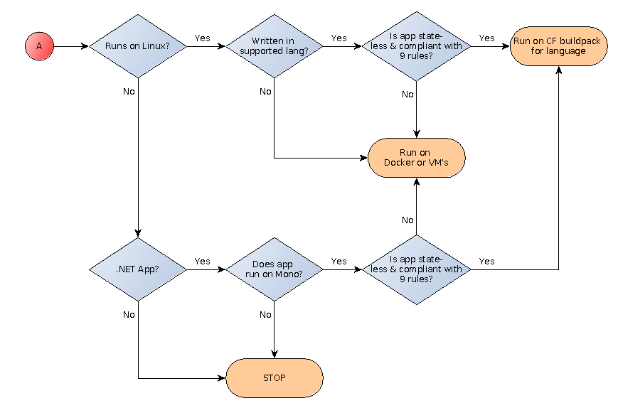
Simplified Migration Flowchart

Slide 32
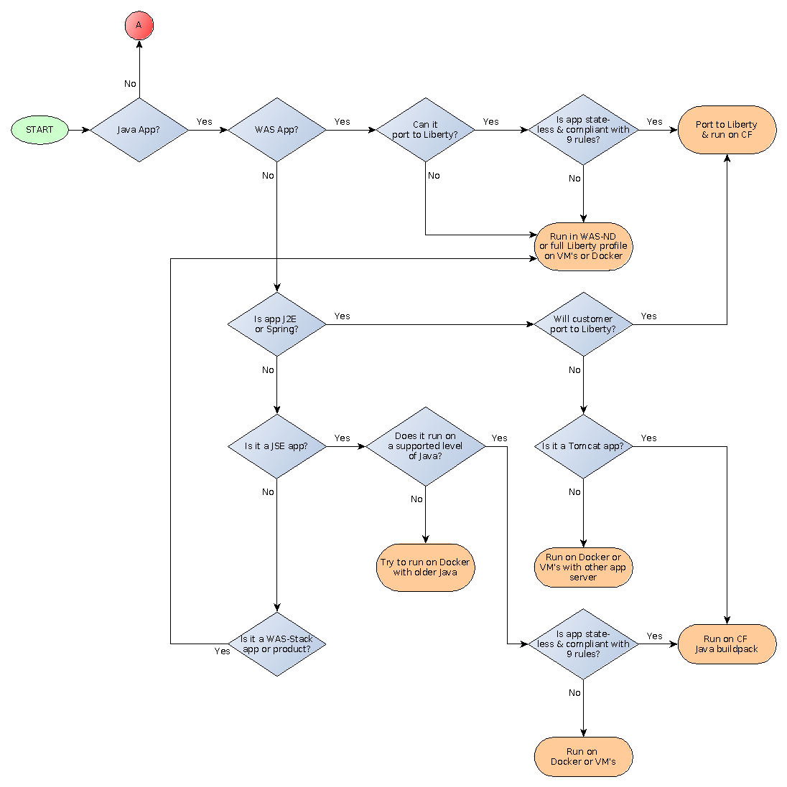
More complete Migration Options

Slide 33
 | Bluemix Cloud Foundry Runtimes | IBM Container Service | HEAT Patterns or PureApp Services Patterns
Optimal System Type | Systems of Engagement | Either | Systems of Record
Optimal Application Type | Cloud Centric | Either, but most commonly Cloud Centric | Cloud Ready
Scaling | Horizontally scaled single-process solutions (Vertical scaling limited by 4GB limit on DEAs) | High density vertically scaled single-process solutions | Horizontally scaled complex multi-process assemblies,
Composition Model | Service Composition model | Runtime assembly model compatible with Service composition | Runtime assembly model for complex multi-runtime systems
Cloud solution type | Public or managed private cloud solution | Public, Private or managed cloud solutions and local development | Private cloud solutions
DevOps Integration | Integrated with DevOps Pipeline | Integrated with DevOps Pipeline (Bluemix public) and Integrated with UCD | Integrated with UCD
Security | Limited security options | Not yet explored | Corporate Grade security options
Middleware coverage | Limited traditional middleware functionality | Limited but growing WAS and stack options | Full set of WAS stack products and partner products available

Slide 34
Choosing Core Services

Slide 35

Polyglot Persistence
A basic assumption is that your application will probably have to store some data persistently (e.g. for longer than the length of a single user session)
At one time, it was a simple assumption that Web programs would run on a relational database
Multiple relational database options exist for Bluemix
However the assumption of using a SQL database (DB2, MySQL, etc.) should be challenged by the set of open-source data options collectively called “NoSQL”
These data stores are characterized into four different basic types that are each specifically qualified for different purposes

Slide 36

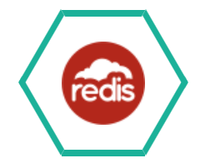




NoSQL Options
Cloudant – High Performance JSON document Database built on Apache CouchDB. Built in support for map/reduce. Useful in nearly any NoSQL situation.
Redis by Compose – BSD-licensed Key-value store. Especially useful for leaderboards and document ranking.
Mongodb by Compose – open-source document DB (documents similar to JSON objects). Often used for log data, product data management and content management.
RedisCloud and MongoLab also provide third-party Redis and Mongo hosting services.
Graph Data Store - built on Apache Tinkerpop and is especially useful for modeling social networks.

Slide 37




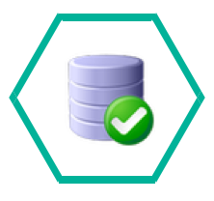

SQL Database Options
The SQL options for storing data vary by functionality and the amount of scaling and multi-tenancy that they support
The SQL Database service provides a DB2 Database (not a DB2 Instance) that is unique to a space and suitable for low-volume applications
The DB2 on Cloud Service provides a DB2 Instance that is unique to a space and can scale up to Enterprise sizes
Both DB2 options are fully compatible with existing DB2 drivers and SQL syntax
PostgreSQL on Compose and Elephant SQL (third party) provide implementations of Postgres.
ClearDB and the (experimental) MySQL Service both provide implementations of MySQL
In the end, the decision is usually based on what database the team (and their DBA’s) are most comfortable with.

Slide 38
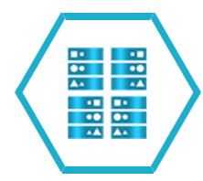


Storing Data Temporarily
For performance reasons (or for scalability of session-type data) you may find the need to store data for the duration of a user session
There’s also the need to cache commonly accessed data rather than pull it from a database, especially a relational database.
The Session Cache service is specific to the Liberty buildpack and implements the JEE Session API.
The Data Cache service implements a highly available key-value cache with API’s for Java, Node and REST
The Memcached service hosts a distributed key-value cache using the widely available Memcached API’s
These should not be used as systems of record – they are explicitly unreliable and may suffer from any of the standard problems (staleness, etc) that distributed caches suffer from. A Cache is not a database!

Slide 39



Communicating between services asynchronously
Sometimes there is the need to add asynchronicity between stages of a business application. For instance, commonly a web site will need immediate response, while processing an order could be an operation that takes hours or days.
Asynchronous messaging systems allow different services to run at different speeds
MQLight is a fully-featured AMQP-based messaging engine with clients for Java, Node, Ruby and Python
CloudAMQP hosts the open-source RabbitMQ AMQP-based messaging engine
There is also an experimental RabbitMQ Service available from Bluemix Labs.
None of these solutions is capable of being an Enterprise messaging solution or tying to those – you still need to use MQ Series and the Secure Gateway for that.

Slide 40




Communicate with the world outside Bluemix (Gateways)
A Gateway allows you to bridge between code running inside a Bluemix runtime and people and services that exist outside the Bluemix environment.
Twilio allows you to communicate via Voice and SMS
SendGrid allows you to communicate via Email
IOT allows you to send and receive MQTT messages through the Internet Of Things Foundation
API Management allows you to create Bluemix services from existing API’s in your enterprise and to manage those API’s
Secure Gateway allows you to connect to resources behind your corporate firewall
While Twilio and SendGrid normally act as Data Sinks the Secure Gateway may support limited cases of bidirectional communication

Slide 41
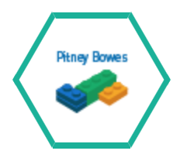




Validating, Cleansing and Converting Data
The Pitney-Bowes Geocoding and Reverse Geocoding services map GPS coordinates to postal addresses, and vice versa
DataWorks allows you to move data from one database to another and also validates postal addresses
Watson Language Translation converts text between several natural languages
Presence Insights helps you Geolocate a user’s device within a venue to provide them with location-specific information
Geospacial analytics gives you MQTT notification when a device moves within a bounded area
Think of these as pipes or filters in a data pathway. Either you’re moving data from
one place to another, or changing, converting or augmenting that data

Slide 42


